Slide 1
Let’s wake up

Slide 2
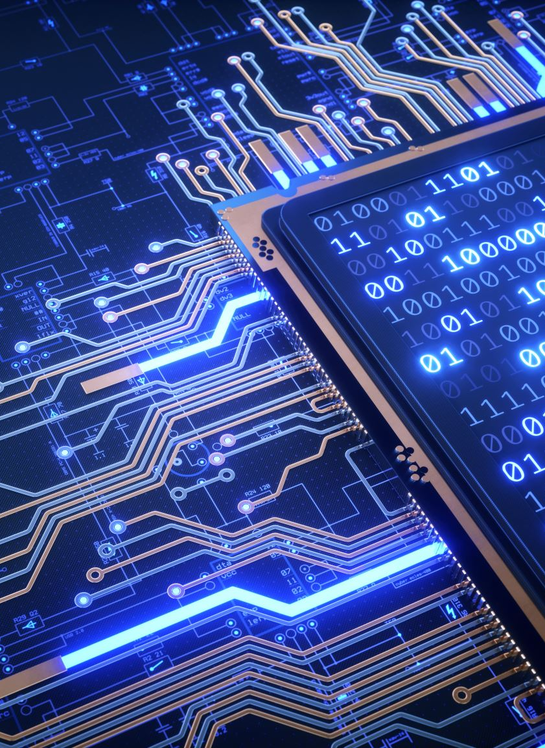
TPUs, GPUs, CPUs and edge devices
Dr. Umberto Michelucci
umberto.michelucci@gmail.com
079 396 7406

Slide 3
A bit of context

Slide 4
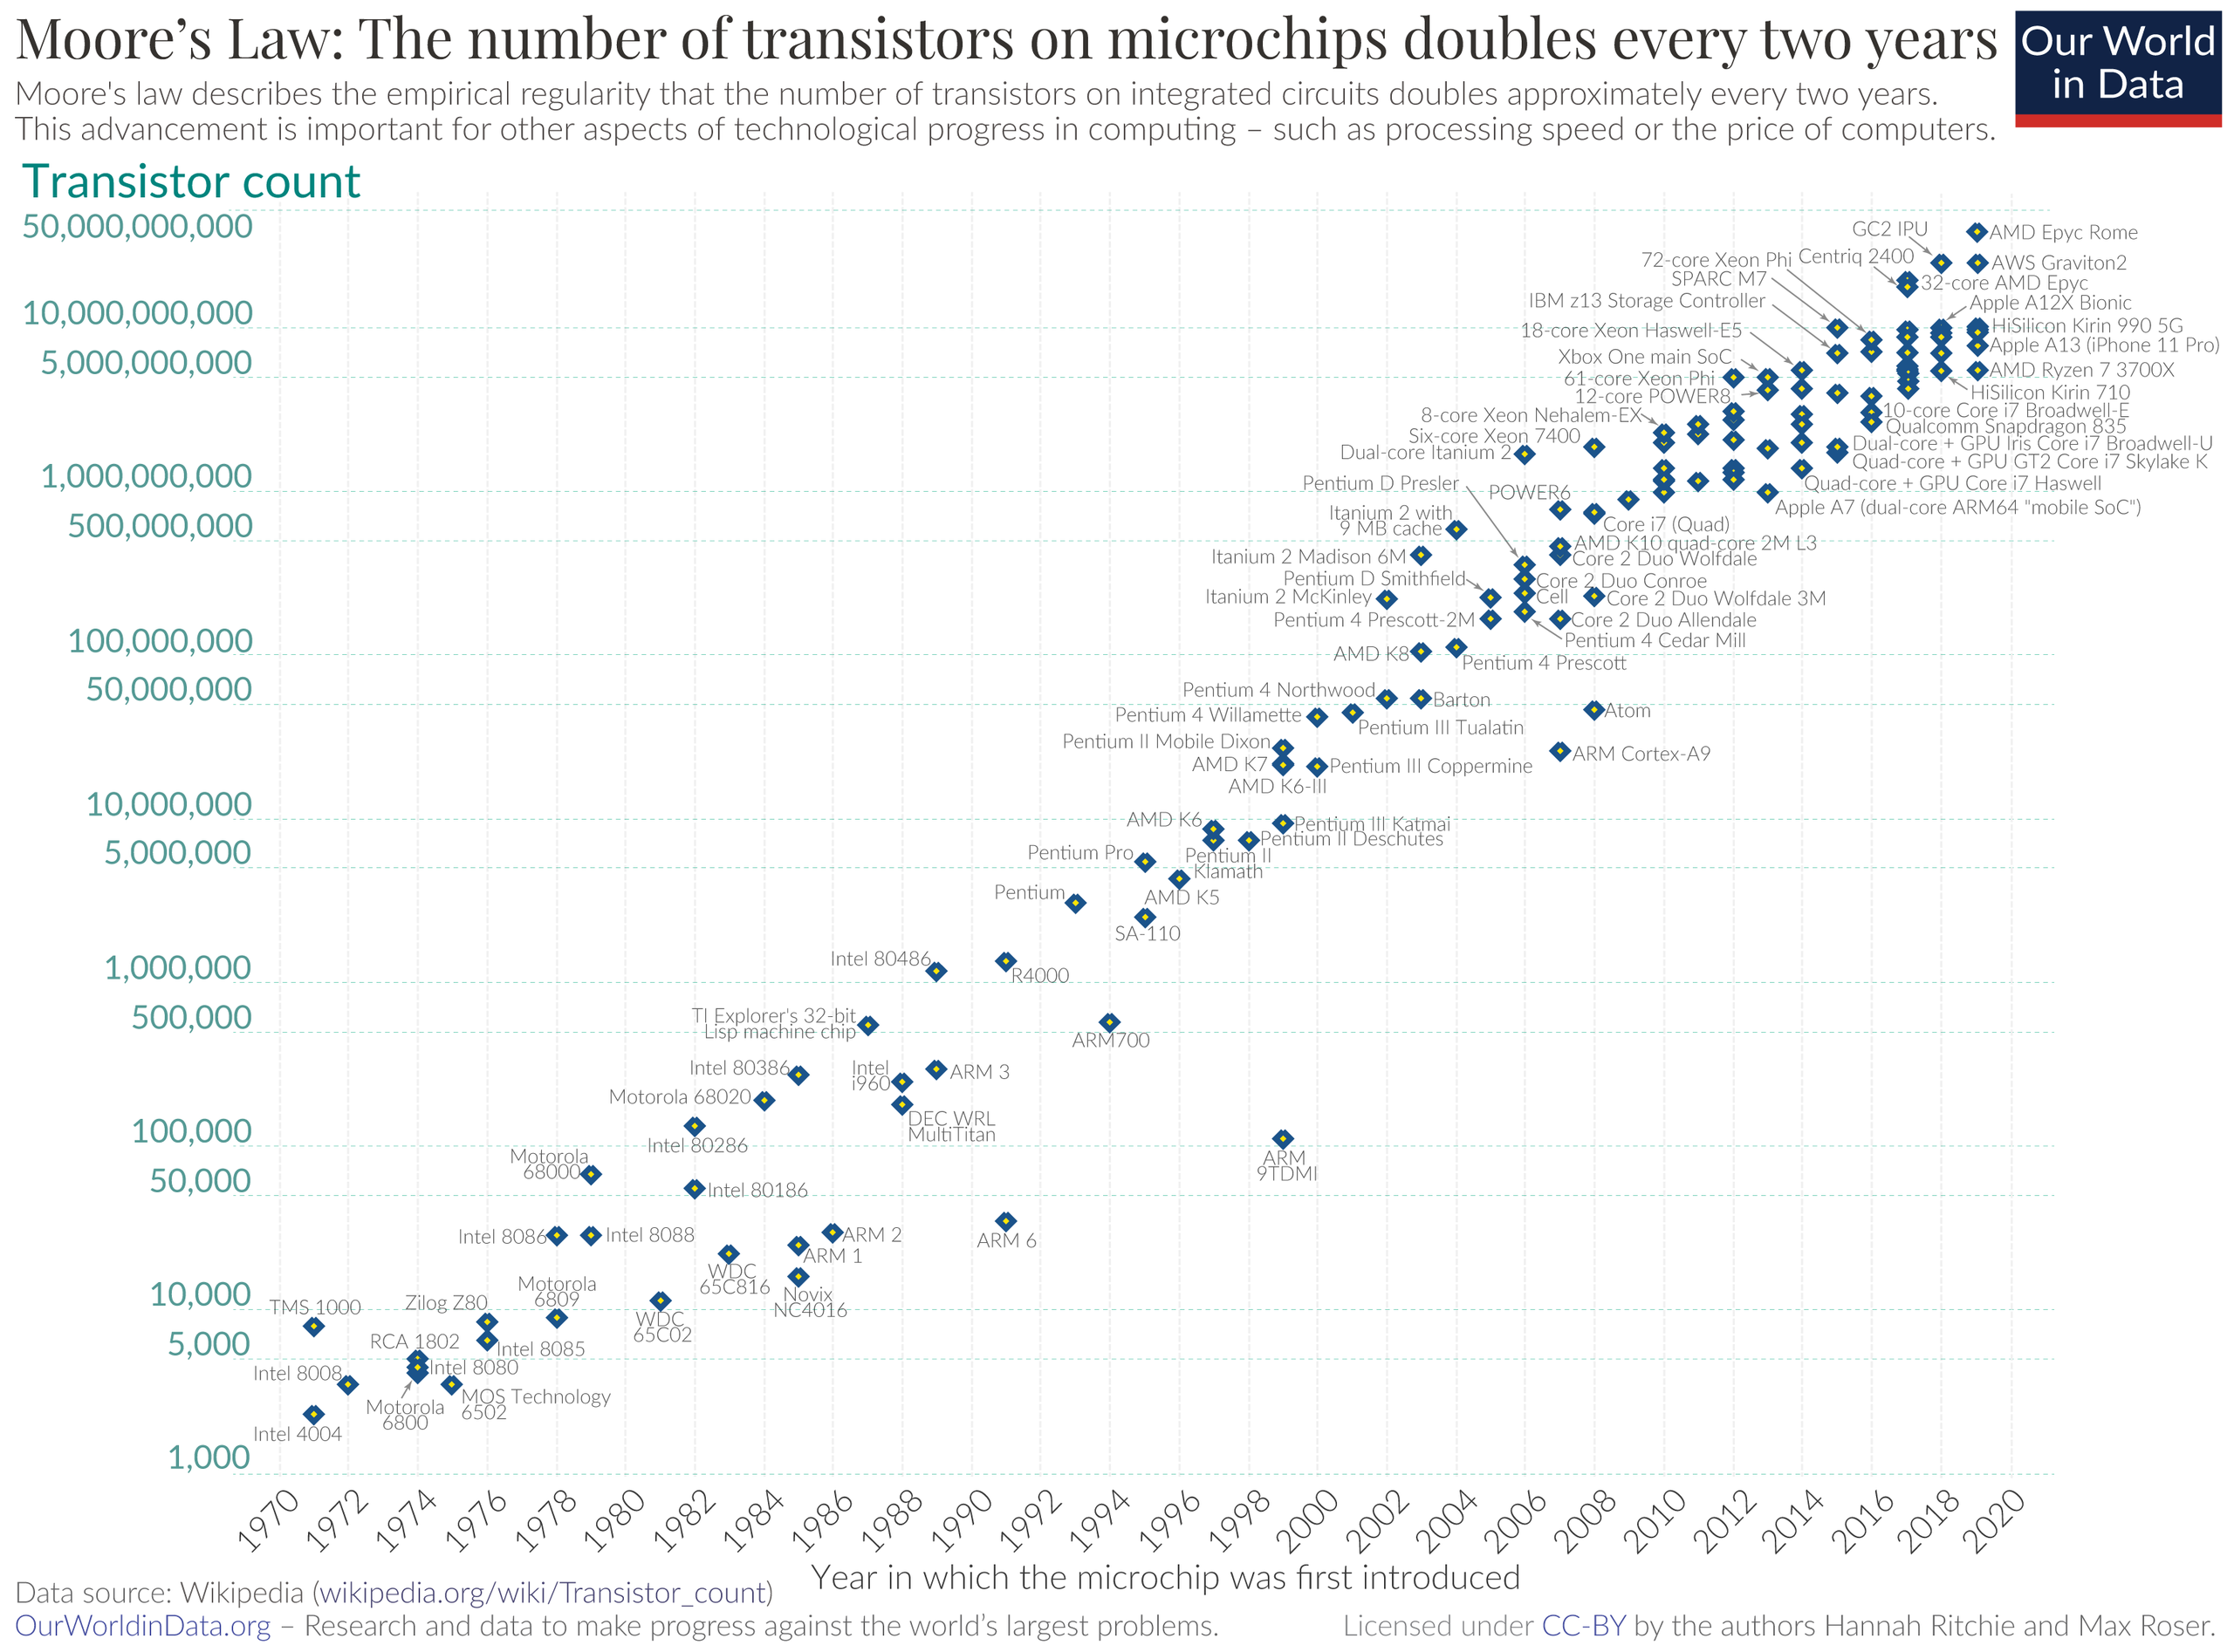
Quelle: https://en.wikipedia.org/wiki/Moore%27s_law#/media/File:Moore's_Law_Transistor_Count_1970-2020.png

Slide 5
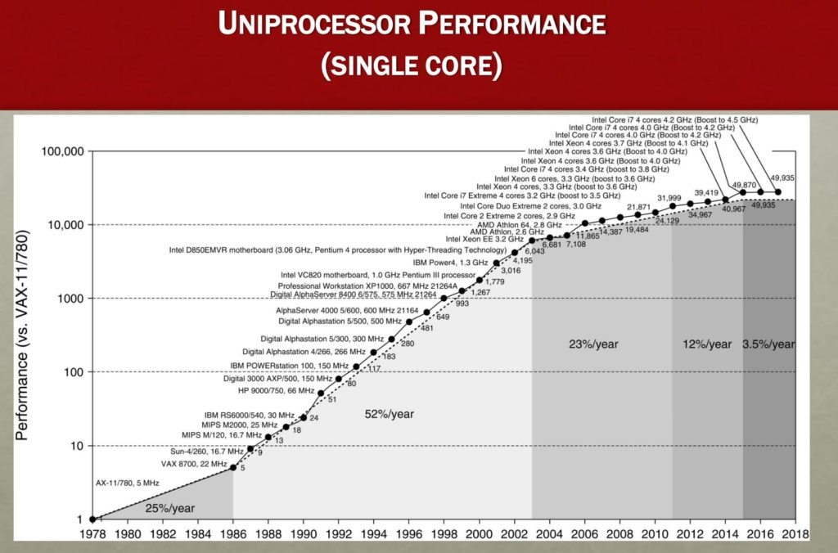
Quelle: https://www.nextbigfuture.com/2019/02/the-end-of-moores-law-in-detail-and-starting-a-new-golden-age.html

Slide 6
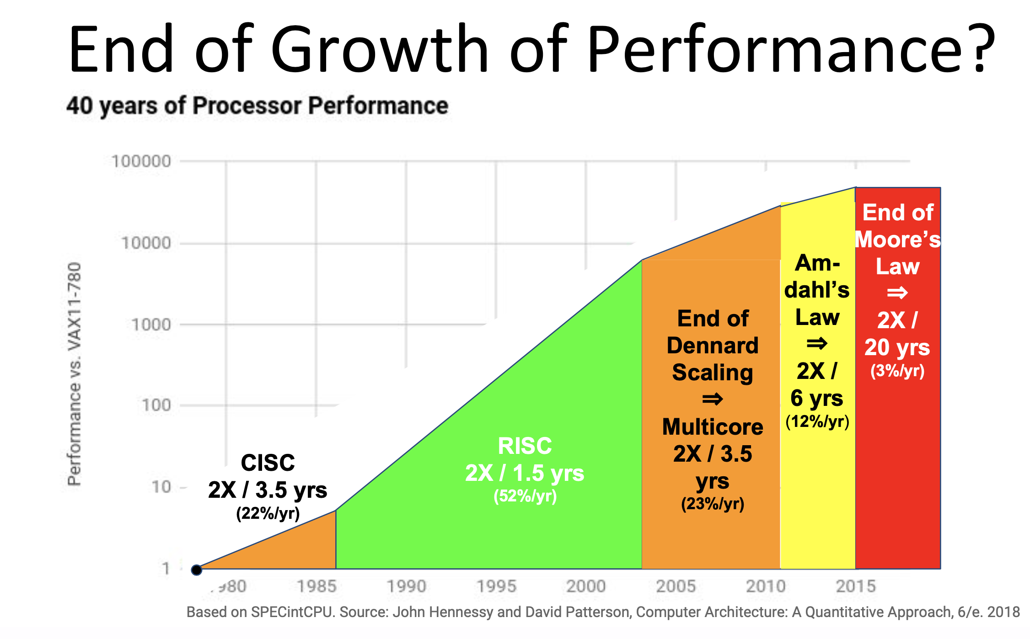
“Moore's law is the observation that the number of transistors in a dense integrated circuit doubles about every two years”. From Wikipedia
Diagram source: NAE Regional Meeting: https://sites.google.com/view/naeregionalsymposium

Slide 7
To overcome the limitations we need to use task specific architectures
Task specific architecture: an architecture that does one thing and only one, but very efficiently.

Slide 8
A CPU does the computation in a sequential process
Multiply-add operation on CPU. Credits for this image go to this Google Cloud article.

Slide 9
A GPU parallelize many sequential processes
Multiply-add operation on GPU. Credits for this image go to this Google Cloud article.

Slide 10
Tensor Processing Unit (TPU)

Slide 11
TPU uses an architecture called systolic architecture
systolic execution architecture:
this works with data arriving at cells at regular intervals from different directions, more on that later. The computation can be carried out without accessing memory

Slide 12
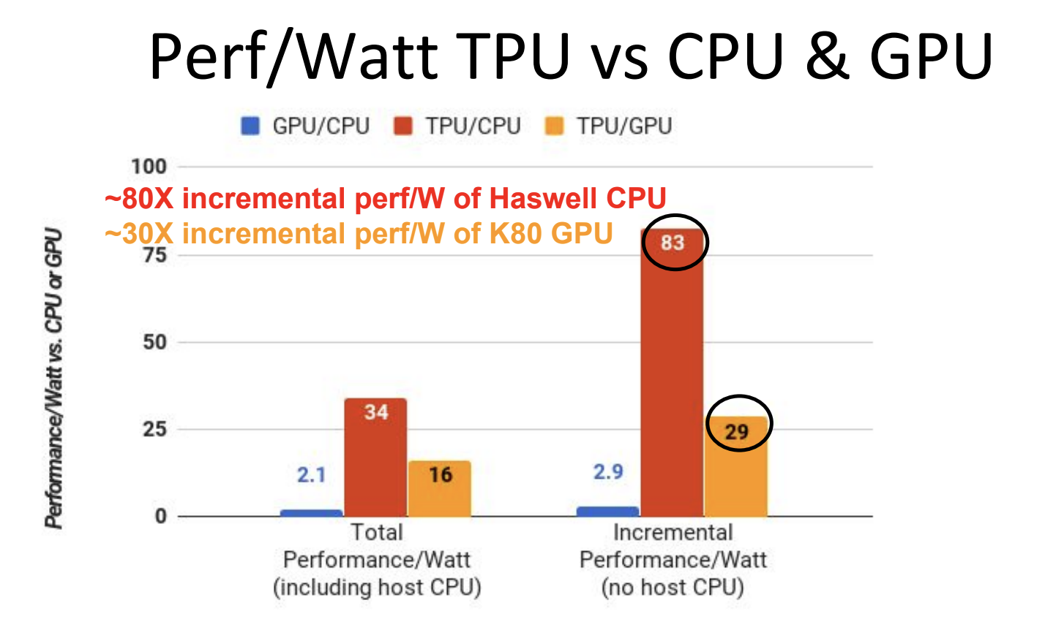
TPUs turn out to be very energy efficient
NAE Regional Meeting: https://sites.google.com/view/naeregionalsymposium

Slide 13
Carbon footprint of training networks*
A single PC
Consider an Intel i7, according to specs it dissipates 95W → When working 24h it needs 2.28 kWh
GPU Nvidia 1080Ti, according to specs it dissipates 250 W → When working 24h it needs 6 kWh
A datacenter
Up to 5000 GPUs, CPU with 8 cores (ca. 10k CPUs) → 52.8 MWh (MEGA WATT PER HOURS PER DAY). A windmill produces roughly 12 MWh per day, that is enough for ca. 400-500 households...
* https://towardsdatascience.com/the-carbon-footprint-of-ai-research-812d9c974a5c

Slide 14
TPU Limitations
Linear algebra programs that require frequent branching or are dominated by element-wise algebra;
Workloads that access memory in a sparse manner;
Workloads that require high-precision arithmetic;
Neural network workloads that contain custom TensorFlow operations written in C++, specifically, custom operations in the body of the main training loop.
Source: https://medium.com/sciforce/understanding-tensor-processing-units-10ff41f50e78

Slide 15
TPU

Slide 16
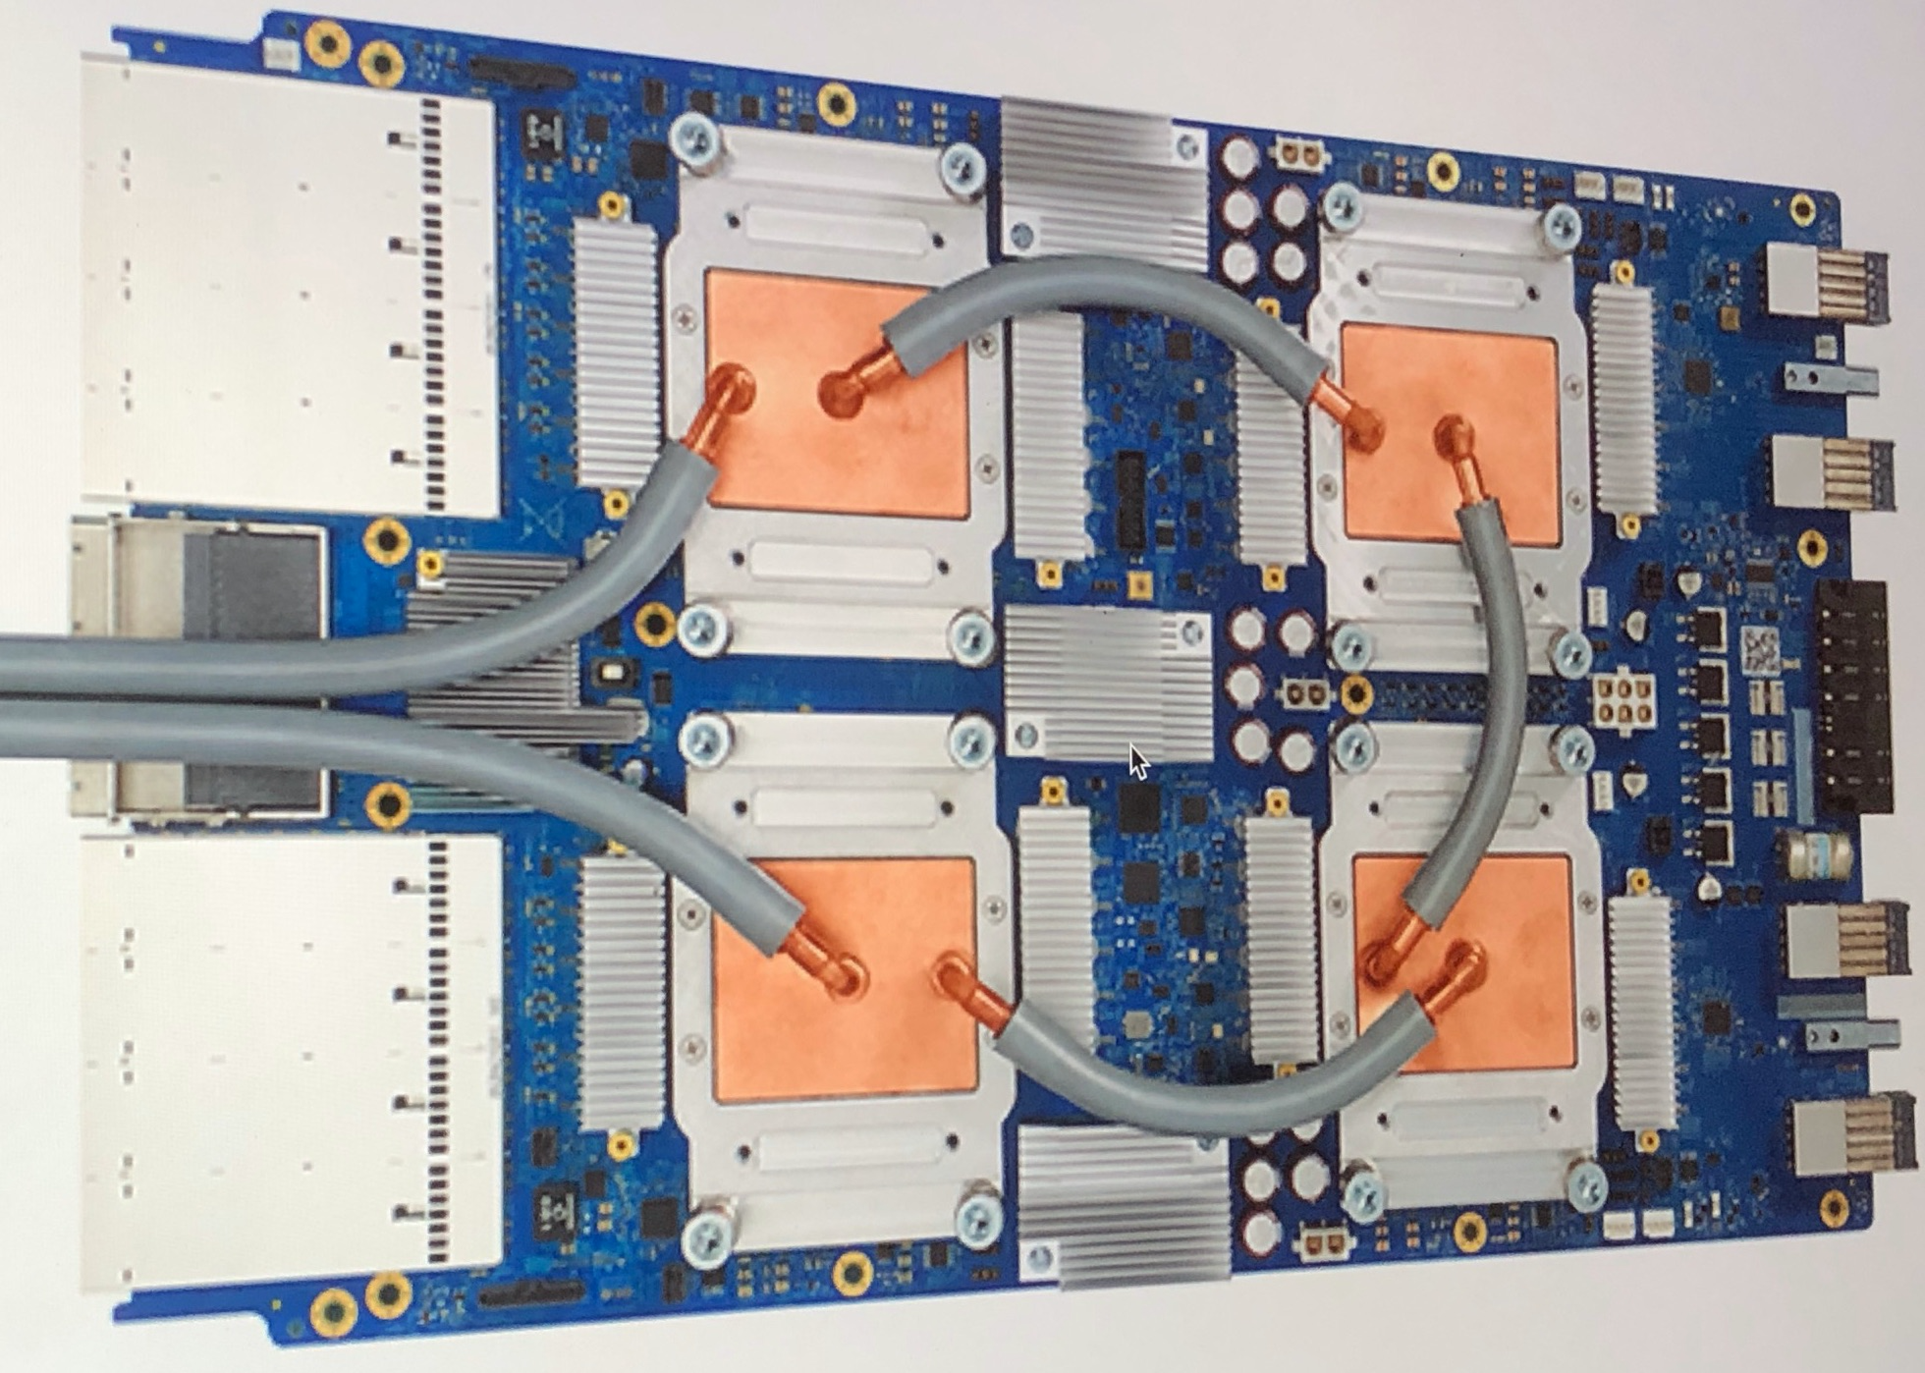
TPU
ASIC (Application Specific Integrated Circuit)

Slide 17
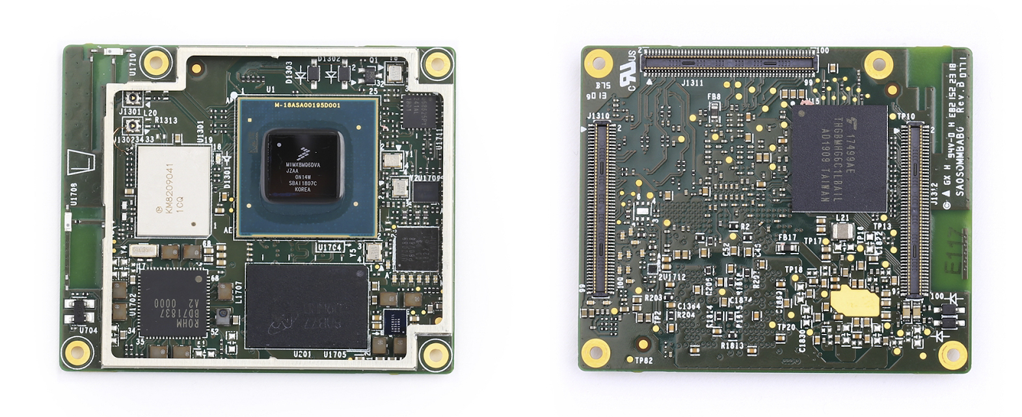
Coral Edge TPU
ASIC (Application Specific Integrated Circuit)

Slide 18
TPU version
Multiply-add operation on TPU. Credits for this image go to this Google Cloud article.

Slide 19
Key enabler of the performance of TPUs
The key enabler is a major reduction of the von Neumann bottleneck.
The shared bus between the program memory and data memory leads to the von Neumann bottleneck, the limited throughput (data transfer rate) between the central processing unit (CPU) and memory compared to the amount of memory*.
* https://en.wikipedia.org/wiki/Von_Neumann_architecture#Von_Neumann_bottleneck

Slide 20
Systolic matrix multiplication example
From: http://www.cs.hmc.edu/courses/2001/spring/cs156

Slide 21
Systolic matrix multiplication example
b[2,2]
b[1,2]
b[0,2]
b[2,0]
b[1,0]
b[0,0]
t = 0
a[0,2] a[0,1] a[0,0]
b[2,1]
b[1,1]
b[0,1]
a[1,2] a[1,1] a[1,0]
a[2,2] a[2,1] a[2,0]

Slide 22
Systolic matrix multiplication example
b[2,2]
b[1,2]
b[0,2]
b[2,1]
b[1,1]
b[0,1]
t = 1
b[2,0]
b[1,0]
b[0,0]
a[0,0]
a[0,0]*b[0,0]
a[0,2] a[0,1]
a[1,2] a[1,1] a[1,0]
a[2,2] a[2,1] a[2,0]

Slide 23
Systolic matrix multiplication example
b[2,2]
b[1,2]
b[0,2]
t = 2
b[2,1]
b[1,1]
b[2,0]
b[1,0]
b[0,1]
a[0,1]
a[0,0]*b[0,0] +a[0,1]*b[1,0]
a[0,0]
a[0,0]*b[0,1]
a[0,2]
b[0,0]
a[1,0]
a[1,0]*b[0,0]
a[1,2] a[1,1]
a[2,2] a[2,1] a[2,0]

Slide 24
Systolic matrix multiplication example
t = 3
b[2,2]
b[1,2]
b[2,1]
b[2,0]
b[1,1]
b[0,2]
a[0,2]
a[0,0]*b[0,0] +a[0,1]*b[1,0]
a[0,1]
a[0,0]*b[0,1]+a[0,1]*b[1,1]
a[0,0]
a[0,0]*b[0,2]
b[1,0]
b[0,1]
a[1,1]
a[1,0]*b[0,0]+a[1,1]*b[1,0]
a[1,0]*b[0,1]
a[1,2]
b[0,0]
a[2,0]
a[2,0]*b[0,0]
a[2,2] a[2,1]

Slide 25
Systolic matrix multiplication example
t = 4
b[2,2]
b[2,1]
b[1,2]
a[0,0]*b[0,0] +a[0,1]*b[1,0]+a[0,2]*b[2,0]
a[0,2]
a[0,0]*b[0,1]+a[0,1]*b[1,1]+a[0,2]*b[2,1]
a[0,1]
a[1,0]*b[0,2]+a[0,1]*b[1,2]
b[2,0]
b[1,1]
b[0,2]
a[1,2]
a[1,0]*b[0,0]+a[1,1]*b[1,0]+a[1,2]*b[2,0]
a[1,1]
a[1,0]*b[0,1]+a[1,1]*b[1,1]
a[1,0]
a[1,0]*b[0,2]
b[1,0]
b[0,1]
a[2,1]
a[2,0]*b[0,0]+a[2,1]*b[1,0]
a[2,0]
a[2,0]*b[0,1]
a[2,2]

Slide 26
Systolic matrix multiplication example
t = 5
b[2,2]
a[0,0]*b[0,0] +a[0,1]*b[1,0]+a[0,2]*b[2,0]
a[0,0]*b[0,1]+a[0,1]*b[1,1]+a[0,2]*b[2,1]
a[0,2]
a[1,0]*b[0,2]+a[0,1]*b[1,2]+a[0,2]*b[2,2]
b[2,1]
b[1,2]
a[1,0]*b[0,0]+a[1,1]*b[1,0]+a[1,2]*b[2,0]
a[1,2]
a[1,0]*b[0,1]+a[1,1]*b[1,1]+a[1,2]*b[2,1]
a[1,1]
a[1,0]*b[0,2]+a[1,1]*b[1,2]
b[2,0]
b[1,1]
b[0,2]
a[2,2]
a[2,0]*b[0,0]+a[2,1]*b[1,0]+
a[2,2]*b[2,0]
a[2,1]
a[2,0]*b[0,1]+a[2,1]*b[1,1]
a[2,0]
a[2,0]*b[0,2]

Slide 27
Systolic matrix multiplication example
t = 6
a[0,0]*b[0,0] +a[0,1]*b[1,0]+a[0,2]*b[2,0]
a[0,0]*b[0,1]+a[0,1]*b[1,1]+a[0,2]*b[2,1]
a[1,0]*b[0,2]+a[0,1]*b[1,2]+a[0,2]*b[2,2]
b[2,2]
a[1,0]*b[0,0]+a[1,1]*b[1,0]+a[1,2]*b[2,0]
a[1,0]*b[0,1]+a[1,1]*b[1,1]+a[1,2]*b[2,1]
a[1,2]
a[1,0]*b[0,2]+a[1,1]*b[1,2]+a[1,2]*b[2,2]
b[2,1]
b[1,2]
a[2,0]*b[0,0]+a[2,1]*b[1,0]+
a[2,2]*b[2,0]
a[2,2]
a[2,0]*b[0,1]+a[2,1]*b[1,1]+a[2,2]*b[2,1]
a[2,1]
a[2,0]*b[0,2]+a[2,1]*b[1,2]

Slide 28
Systolic matrix multiplication example
t = 7
a[0,0]*b[0,0] +a[0,1]*b[1,0]+a[0,2]*b[2,0]
a[0,0]*b[0,1]+a[0,1]*b[1,1]+a[0,2]*b[2,1]
a[1,0]*b[0,2]+a[0,1]*b[1,2]+a[0,2]*b[2,2]
a[1,0]*b[0,0]+a[1,1]*b[1,0]+a[1,2]*b[2,0]
a[1,0]*b[0,1]+a[1,1]*b[1,1]+a[1,2]*b[2,1]
a[1,0]*b[0,2]+a[1,1]*b[1,2]+a[1,2]*b[2,2]
b[2,2]
a[2,0]*b[0,0]+a[2,1]*b[1,0]+
a[2,2]*b[2,0]
a[2,0]*b[0,1]+a[2,1]*b[1,1]+a[2,2]*b[2,1]
a[2,2]
a[2,0]*b[0,2]+a[2,1]*b[1,2]+
a[2,2]*b[2,2]

Slide 29
Systolic matrix multiplication example
Done
a[0,0]*b[0,0] +a[0,1]*b[1,0]+a[0,2]*b[2,0]
a[0,0]*b[0,1]+a[0,1]*b[1,1]+a[0,2]*b[2,1]
a[1,0]*b[0,2]+a[0,1]*b[1,2]+a[0,2]*b[2,2]
a[1,0]*b[0,0]+a[1,1]*b[1,0]+a[1,2]*b[2,0]
a[1,0]*b[0,1]+a[1,1]*b[1,1]+a[1,2]*b[2,1]
a[1,0]*b[0,2]+a[1,1]*b[1,2]+a[1,2]*b[2,2]
a[2,0]*b[0,0]+a[2,1]*b[1,0]+
a[2,2]*b[2,0]
a[2,0]*b[0,1]+a[2,1]*b[1,1]+a[2,2]*b[2,1]
a[2,0]*b[0,2]+a[2,1]*b[1,2]+
a[2,2]*b[2,2]

Slide 30
Example of Google Cloud TPU v2
2 systolic array of 128x128 ALU (Arithmetic Logical Units), for 32,768 ALUs for 16 bit floating point values in a single processor.

Slide 31
Limitations of the Google Coral TPU

Slide 32
Components that are needed in the Coral TPU
The Coral TPU supports only INT8 number format. The output of the TPU is floating point.

Slide 33
Reading material
In-Datacenter Performance Analysis of a Tensor Processing Unit
https://arxiv.org/abs/1704.04760

Slide 34
TensorFlow Lite - a primer

Slide 35
Mobile and embedded devices
Definition of Embedded Devices: An embedded device is an object that contains a special-purpose computing system. The system, which is completely enclosed by the object, may or may not be able to connect to the Internet.
Generally, an embedded device's operating system will only run a single application which helps the device to do its job. Examples of embedded devices include dishwashers, banking ATM machines, routers, point of sale terminals (POS terminals) and cell phones. Devices that can connect to the Internet are called smart or intelligent. If an embedded device can not connect to the Internet, it is called dumb.

Slide 36




What are the limitations of embedded devices
Because embedded systems have limited computing resources and strict power requirements, writing software for embedded devices is a very specialized field that requires knowledge of both hardware components and programming.

Slide 37
What are the main objectives we must keep in mind
Model size
We need a small model (file) size to reduce possible download time and RAM usage.
Latency, Battery and heat
We need to reduce amount of computations needed for inference
Other constraints
We may have additional constraints. For example no UI or user interaction. Or slow computational power.

Slide 38
Process to use a model on the edge
Train and save a model (development machine)
Convert the model (development machine)
Copy the converted model on the device
Run inference with the TF Lite interpreter

Slide 39
Main reason to convert a model
The main reasons to convert the model are
Make it smaller (smaller memory footprint)
Make inference more efficient
Require less memory access
Use less energy in inference
To achieve those goals the main component is what is called QUANTIZATION.

Slide 40
Quantization

Slide 41
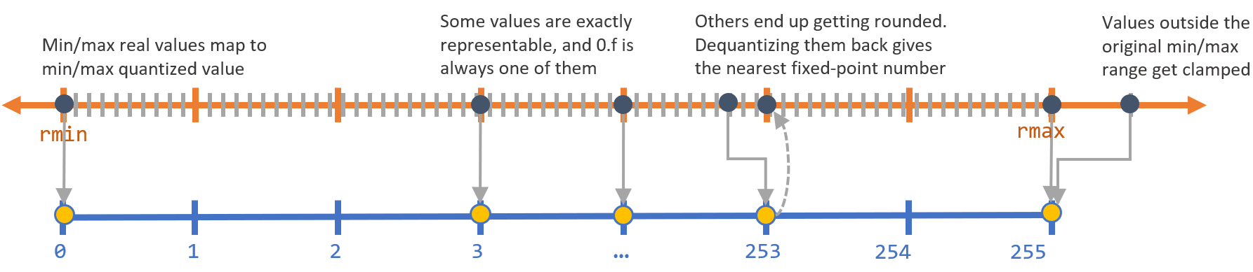
Quantization
Source: https://sahnimanas.github.io/post/quantization-in-tflite/#deep_compression

Slide 42
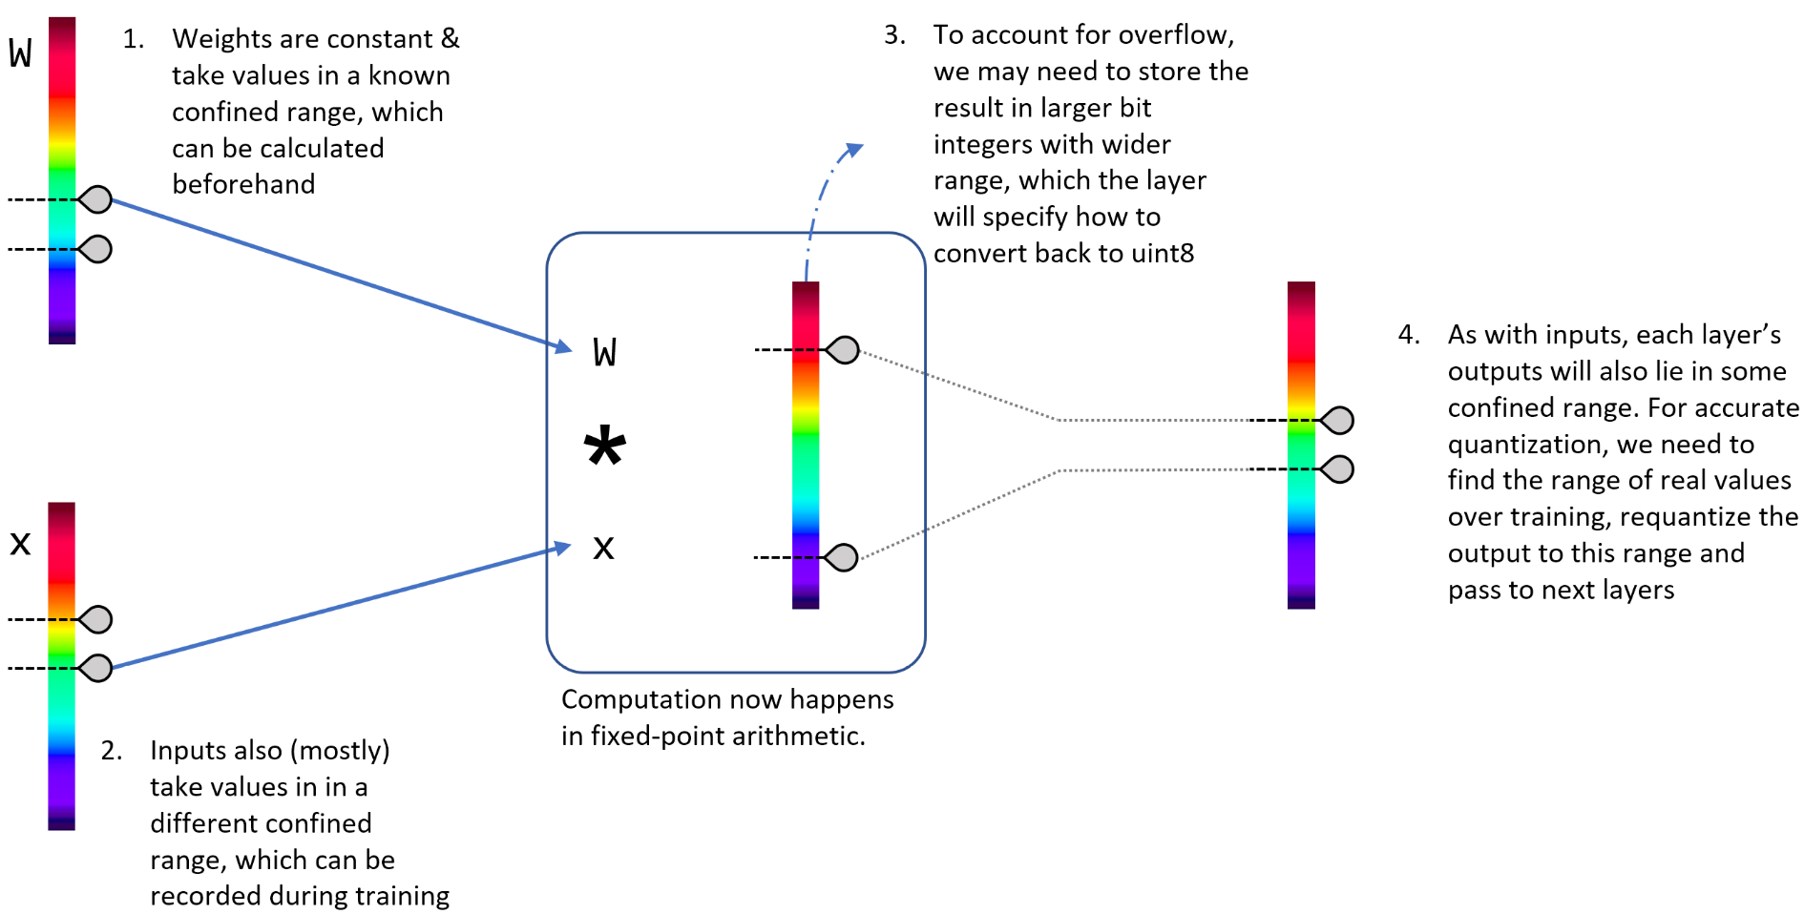
Quantization and overflow
Source: https://sahnimanas.github.io/post/quantization-in-tflite/#deep_compression

Slide 43
There two types of quantization
Post-training quantization - more simple and easier to implement and in most cases extremely efficient
Training-aware quantization - more complex that require the re-writing of the computational graph (see for example https://github.com/tensorflow/tensorflow/tree/r1.13/tensorflow/contrib/quantize)

Slide 44

How TensorFlow lite quantize
Per-axis (aka per-channel in Conv ops) or per-tensor weights are represented by int8 two’s complement values in the range [-127, 127] with zero-point equal to 0. Per-tensor activations/inputs are represented by int8 two’s complement values in the range [-128, 127], with a zero-point in range [-128, 127].
Activations are asymmetric (zero point anywhere in the range)
Weights are symmetric (zero point where the original zero is) (we don’t need to multiply by zero, and the weights that are zero remains zero)
Source: https://www.tensorflow.org/lite/performance/quantization_spec

Slide 45
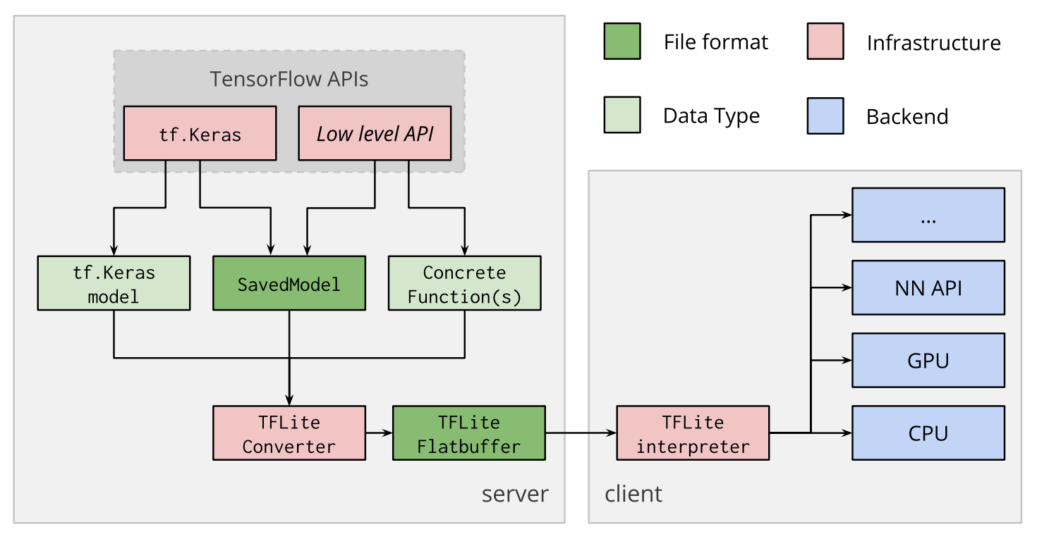
Deployment of a model on a device
Source: https://www.tensorflow.org/lite/convert/index#device_deployment

Slide 46
An introduction to TF Lite

Slide 47
TensorFlow lite converter
import tensorflow as tf
converter = tf.lite.TFLiteConverter.from_saved_model(saved_model_dir)
tflite_model = converter.convert()
open("converted_model.tflite", "wb").write(tflite_model)

Slide 48
TensorFlow Lite converter
The converter generates a TensorFlow Lite FlatBuffer*
Why flatbuffers? Two of the main reasons are:
Access to serialized data without parsing/unpacking
Memory efficiency and speed - The only memory needed to access your data is that of the buffer.
Cross platform code with no dependencies
* FlatBuffers is an efficient cross platform serialization library for C++, C#, C, Go, Java, JavaScript, Lobster, Lua, TypeScript, PHP, Python, and Rust. It was originally created at Google for game development and other performance-critical applications. [https://google.github.io/flatbuffers/]

Slide 49
Post-training Quantization

Slide 50
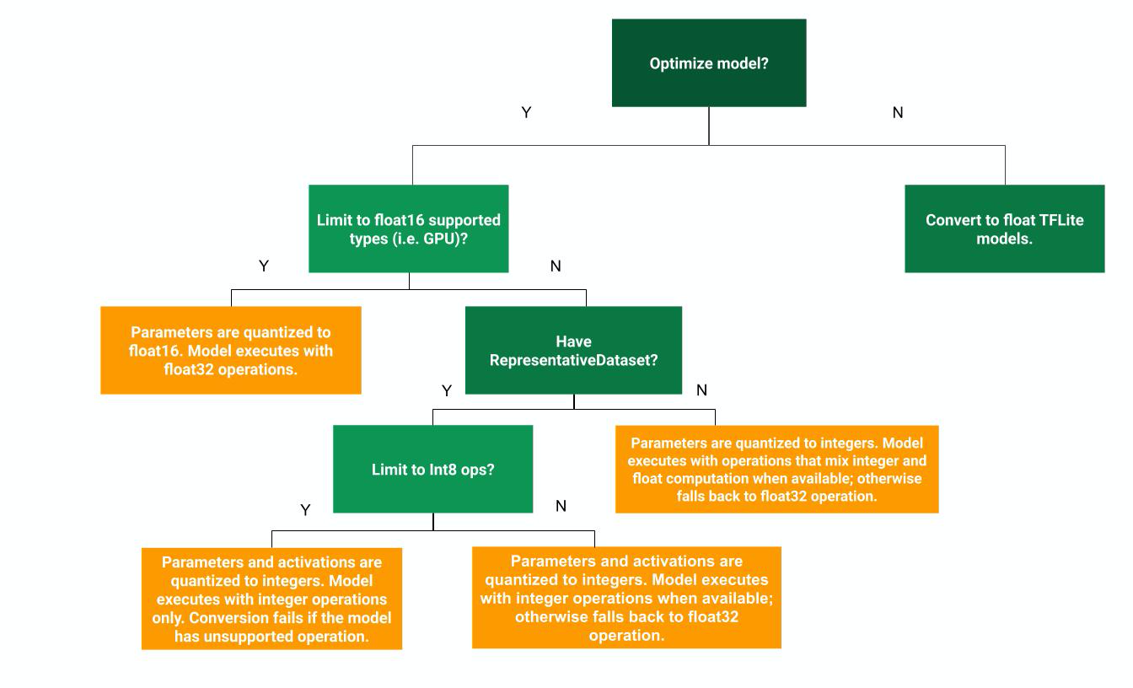
Post-training Quantization decision tree
You cannot quantize the inputs if you have never seen them.
Source: https://www.tensorflow.org/lite/convert/index#device_deployment
Google Coral TPU

Slide 51
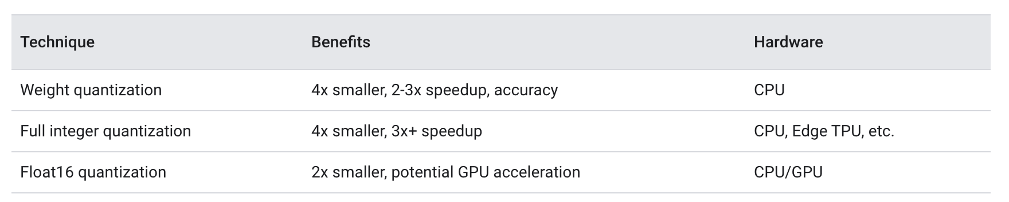
Quantization strategies
Google Coral TPU
Source: https://www.tensorflow.org/lite/performance/post_training_quantization

Slide 52
Hybrid quantization - floating point to 8-bits (weight quantization)
import tensorflow as tf converter = tf.lite.TFLiteConverter.from_saved_model(saved_model_dir) converter.optimizations = [tf.lite.Optimize.OPTIMIZE_FOR_SIZE] tflite_quant_model = converter.convert()
At inference, weights are converted from 8-bits of precision to floating point and computed using floating-point kernels. This conversion is done once and cached to reduce latency.
Source: https://www.tensorflow.org/lite/performance/post_training_quantization

Slide 53
Full integer quantization of weights and activations
To do this, you need to measure the dynamic range of activations and inputs by supplying a representative data set. You can simply create an input data generator and provide it to the converter.
The resulting model should be fully quantized, but any ops that do not have quantized implementations are left in floating point. This allows conversion to occur smoothly, but the model won't be compatible with accelerators that require full integer quantization. Additionally, the model still uses float input and output for convenience.
Source: https://www.tensorflow.org/lite/performance/post_training_quantization

Slide 54
Full integer quantization of weights and activations
import tensorflow as tf
def representative_dataset_gen(): for _ in range(num_calibration_steps): # Get sample input data as a numpy array in a method of your choosing. yield [input] converter = tf.lite.TFLiteConverter.from_saved_model(saved_model_dir) converter.optimizations = [tf.lite.Optimize.DEFAULT] converter.representative_dataset = representative_dataset_gen tflite_quant_model = converter.convert()

Slide 55
Full integer quantization of weights and activations
To ensure compatibility with some accelerators (such as the Coral Edge TPU), you can enforce full integer quantization for all ops and use integer inputs and outputs
Source: official TensorFlow lite documentation

Slide 56
Full integer quantization of weights and activations*
converter.target_spec.supported_ops = [tf.lite.OpsSet.TFLITE_BUILTINS_INT8] converter.inference_input_type = tf.uint8 converter.inference_output_type = tf.uint8 converter.experimental_new_converter = True
* This has been tested with TF version 2.2.0-dev20200113

Slide 57
Compile a model for the Edge TPU
To run a model on the Coral Edge TPU one needs two components:
A model quantized for UINT8 (restricted to operations that support UINT8)
The compiled version of the quantized model
edgetpu_compiler [options] model...

Slide 58
Demo 1 - Size comparison
→ Folder Bootcamp-Deep-Learning-on-Edge-Devices/profiling
# python MobileNetV2_mode_size_comparison.py
-rw-r--r-- 1 umberto staff 14621440 Jan 14 13:57 mobilenetv2.h5
-rw-r--r-- 1 umberto staff 13978380 Jan 14 13:57 mobilenetv2.tflite
-rw-r--r-- 1 umberto staff 3579720 Jan 14 13:57 mobilenetv2_opt.tflite

Slide 59
Effect of TPU
4 layer, each 1024 neurons; MNIST classification; ReLU Activation functions; inference running time
TPU
13.0ms
1.2ms
1.2ms
1.2ms
1.1ms
1.1ms
1.1ms
1.1ms
0.5ms
0.4ms
CPU
38.0ms
37.7ms
37.8ms
37.7ms
37.7ms
37.7ms
37.7ms
37.7ms
37.7ms
37.7ms

Slide 60
The effect of TPU is not always evident
If the operations are between small matrices, you will not see any difference!

Slide 61
Hands-on session (1/4)
https://colab.research.google.com/drive/1v18ICGO9ccTfyo2fKzMbiq9XgQ4zvLik

Slide 62
Hands-on session (2/4)
https://colab.research.google.com/drive/1ob7AexaeWiaQiFWWuak4agcMxXiL0ms7

Slide 63
Hands-on session (3/4)
https://colab.research.google.com/github/google-coral/tutorials/blob/master/retrain_classification_ptq_tf2.ipynb#scrollTo=srOYhMYfx9XH

Slide 64
Hands-on session (3/4)
NOTE: this demo is the same as (2/4) with the only difference that it uses a different network.
https://colab.research.google.com/drive/1NsrA_ABfVulXRfs3HgKvKZyggVuJG0oM

